Slide 1
객체지향 설계 패턴
한동대학교 도서관 책자관리 및 대출시스템 UML 모델링
21600287 박정현
21800201 김현욱
21900136 김신후
21900745 최소미

Slide 2

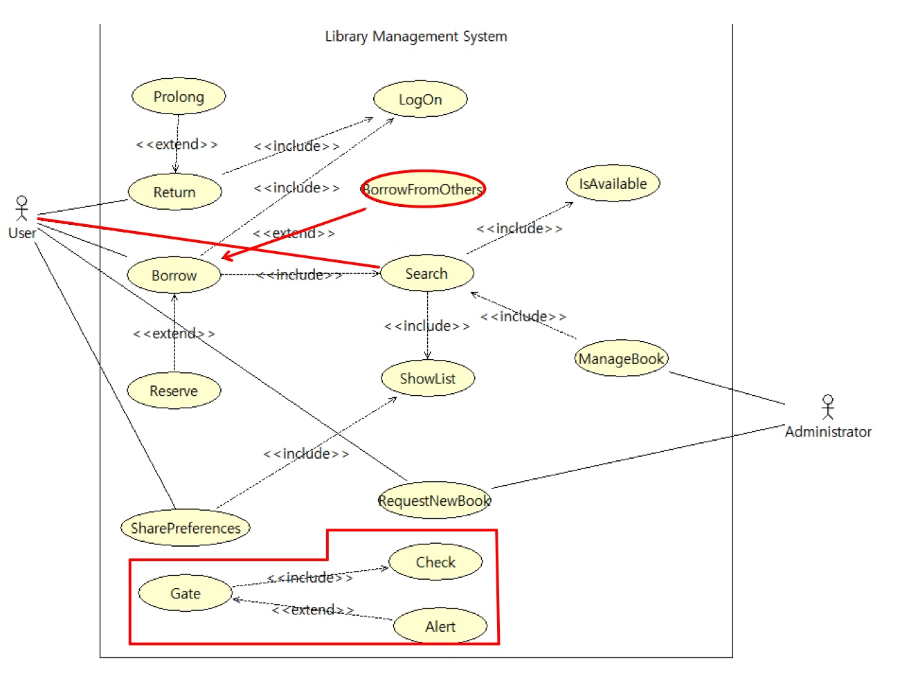

Slide 3

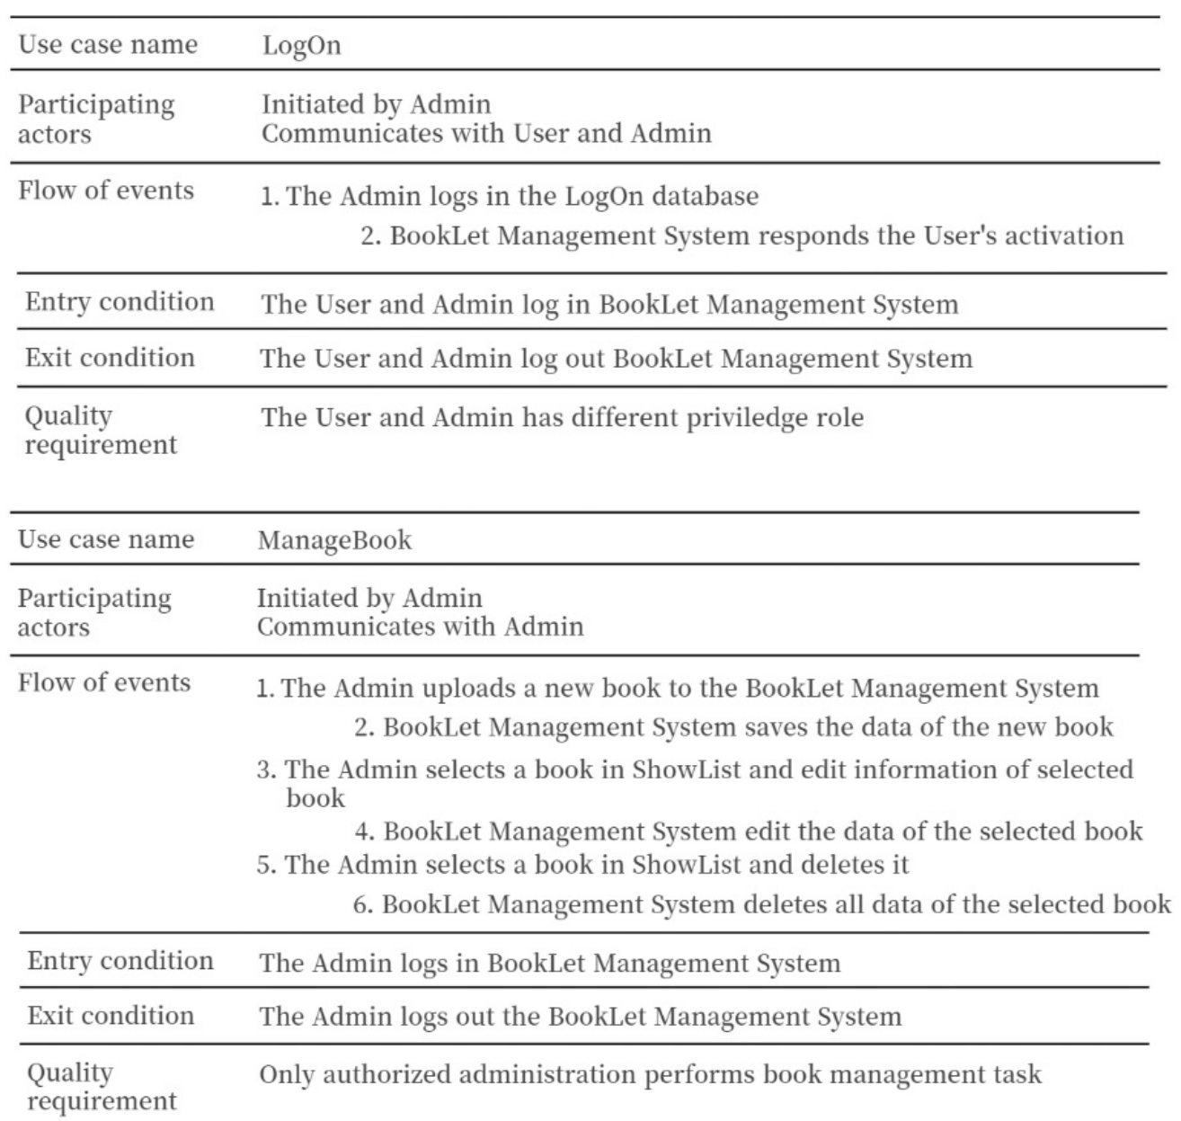
: Original
: New Added

Slide 4
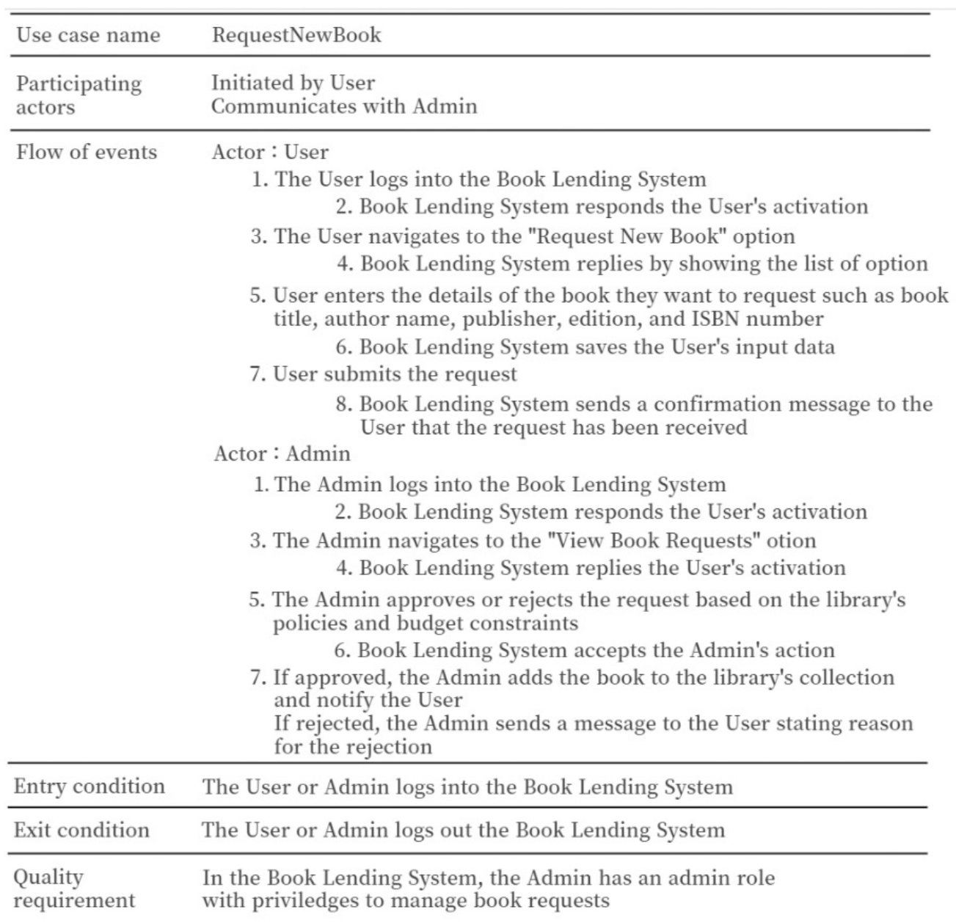
: Original
: New Added

Slide 5
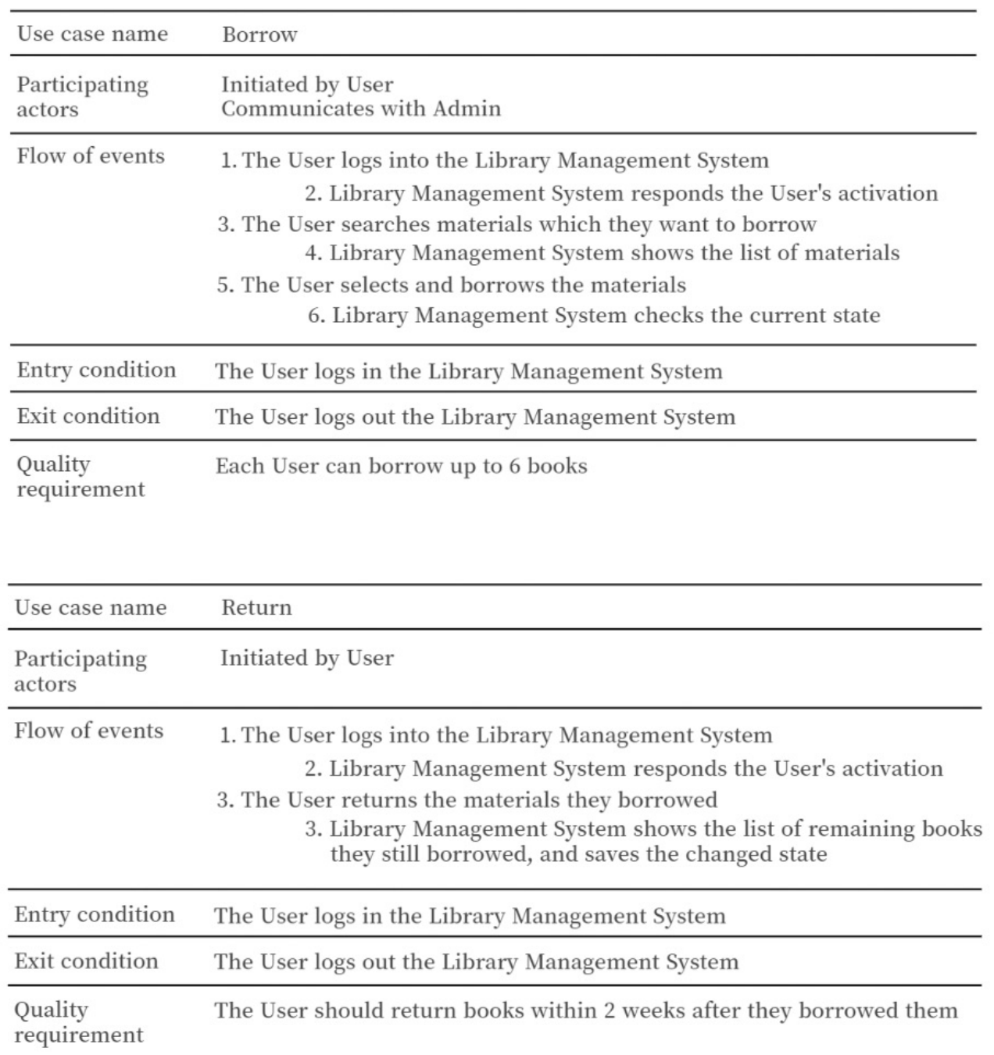
: Original
: New Added

Slide 6
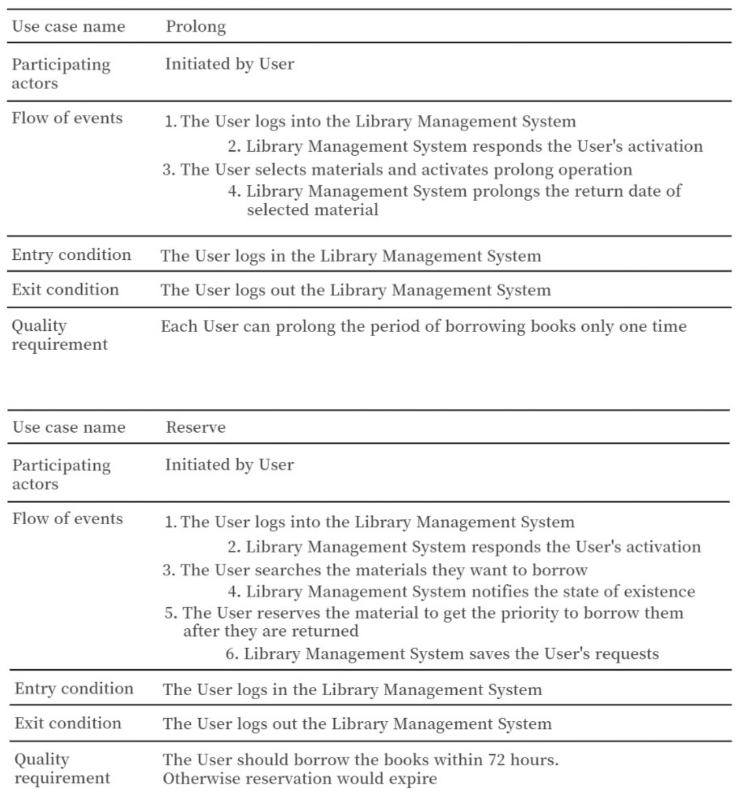
: Original
: New Added

Slide 7
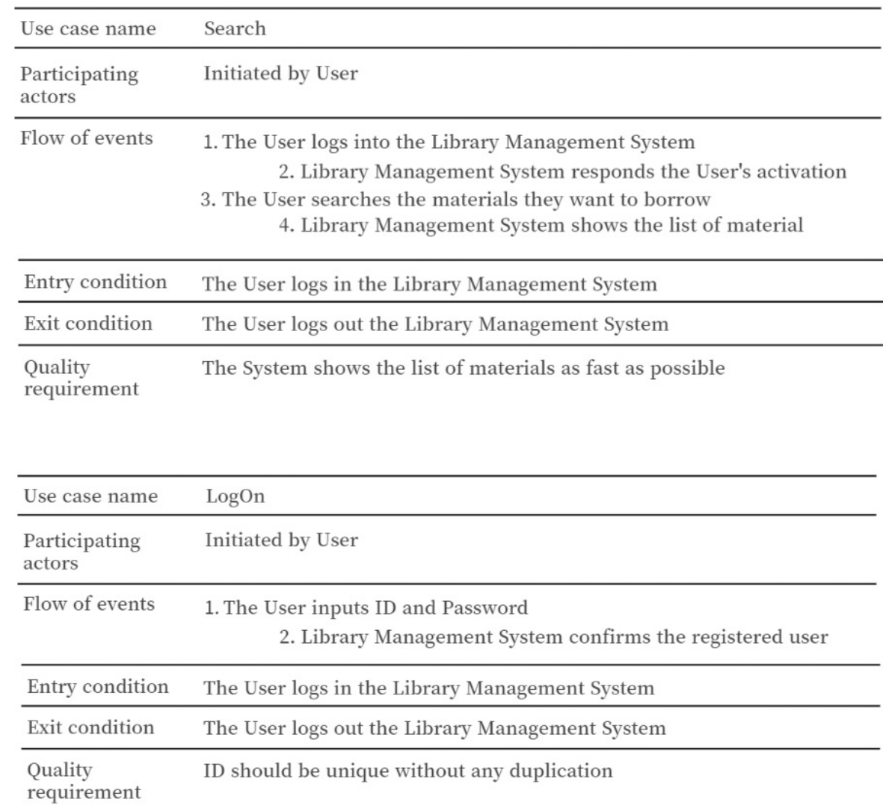
: Original
: New Added

Slide 8
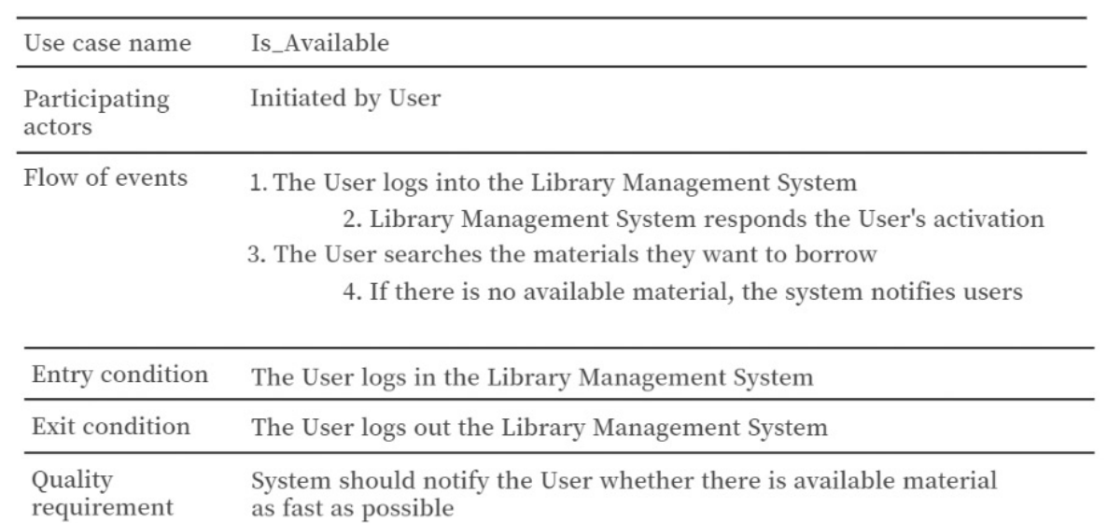
: Original
: New Added

Slide 9
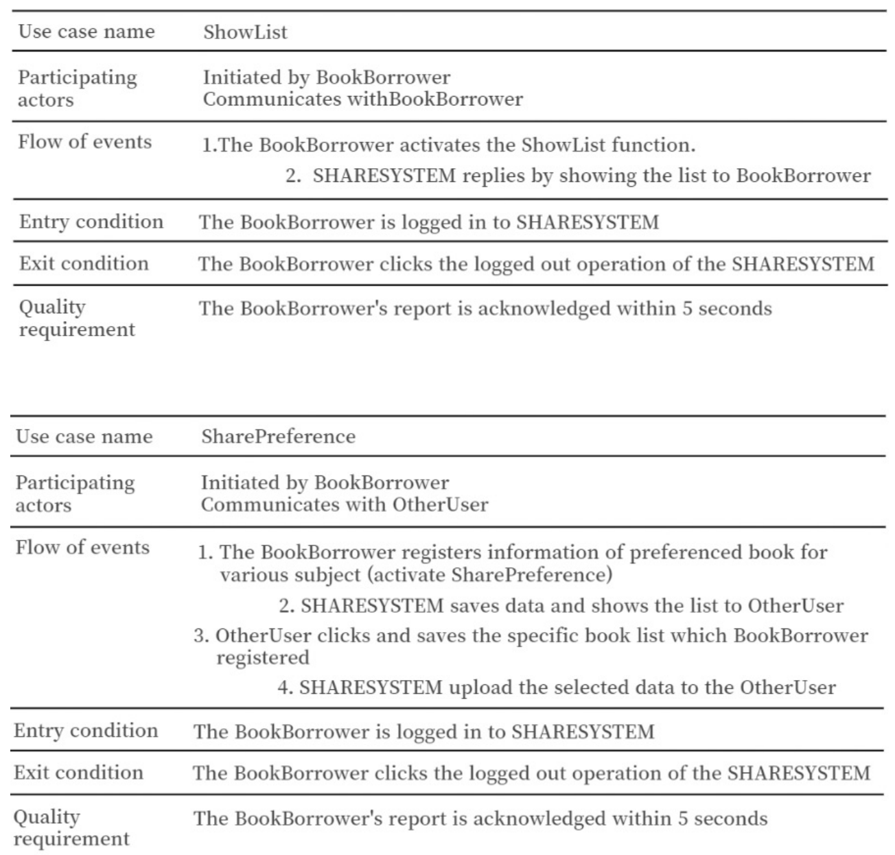
: Original
: New Added

Slide 10
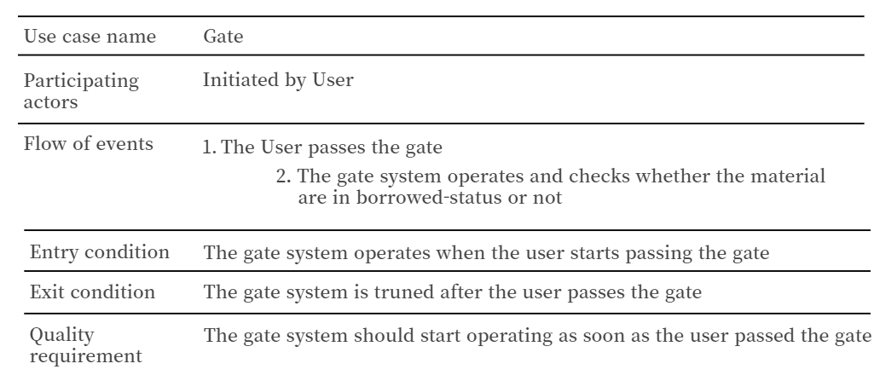
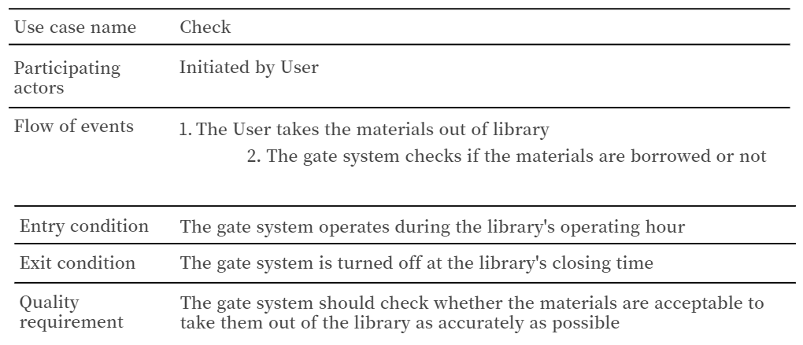
: Original
: New Added

Slide 11
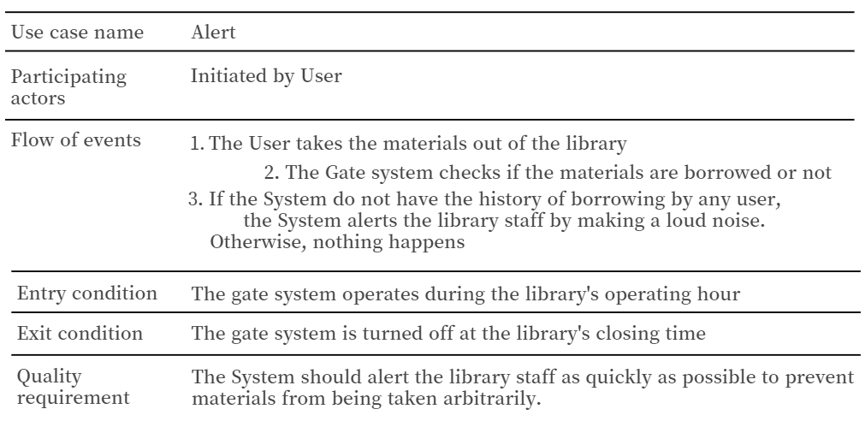
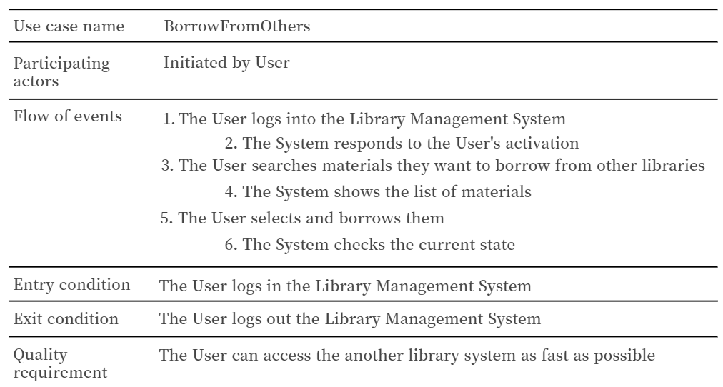
: Original
: New Added

Slide 12

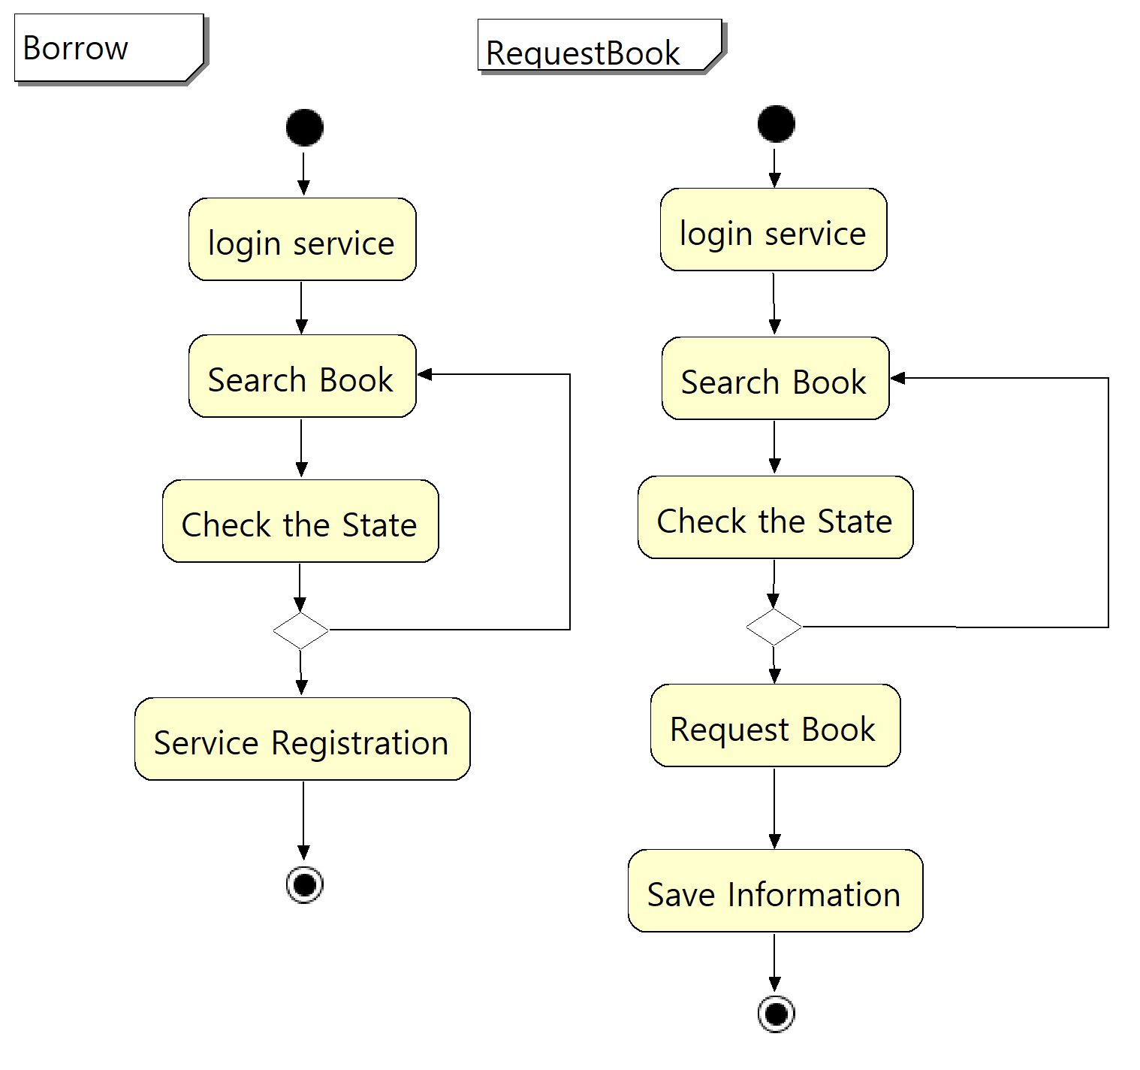

Slide 13

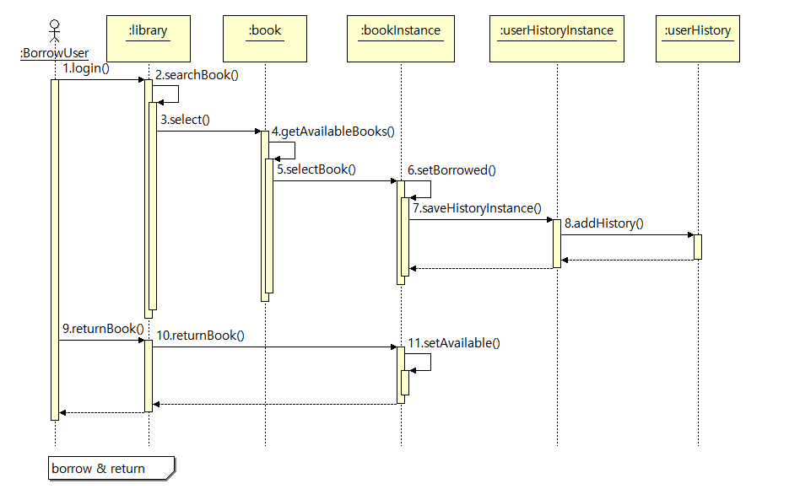

Slide 14

